Slide 1
CMSC 304
Objects in Python
Claire Sparks

Slide 2
Python Objects
An object has both a state and behavior. The state defines the object, and the behavior defines what the object does
class ClassName:
initializer
methods

Slide 3
Python – Creating a Class
Defining a class
The constructor sets two instance variables: x,y
self is the instance of the object
Make sure all instance variables are included in the constructor
class Point:
def __init__(self, x, y): #constructor, 2 arguments
self.x = x
self.y = y

Slide 4
Python – Creating a Class
Make sure all instance variables are included in the constructor
If the user does not call the set_balance method, balance is never initialized
class Customer:
def __init__(self, name): #constructor, 1 argument
self.name = name
def set_balance(self, balance=0.0): #method
# set the customer’s starting balance
self.balance = balance
Notes:
Balance is never initialized because Python is an interpreted language

Slide 5
Python – Creating a Class
Make sure all instance variables are included in the constructor
Now balance is initialized
class Customer:
def __init__(self, name): #constructor, 1 argument
self.name = name
self.balance = 0.0
def set_balance(self, balance):
self.balance = balance

Slide 6
Python Object-Oriented Example
import math
class Point:
def __init__(self, x, y): #constructor, 2 arguments
self.x = x
self.y = y
def __str__(self):
return "I'm a Point at (%d, %d)" % (self.x, self.y)
def distance_from_origin (self):
return math.sqrt(self.x**2 + self.y**2)
def distance(self, p2):
return math.sqrt((p2.x - self.x)**2 + (p2.y - self.y)**2)
pt = Point(10,2)
print(pt) #I'm a point at (10, 2)
print("Distance is: %d" % pt.distance(Point(20,2))) #10.0
Notes:
** is the exponent operator
Supports old school print formatting. Better ways to do this

Slide 7
Assignment Statements
Assignment statements are used to (re)bind names to values and to modify attributes or items of mutable objects
They do not copy objects.
For collections that are mutable or contain mutable items, a copy is sometimes needed so one can change one copy without changing the other.
The copy module provides generic shallow and deep copy operations
  copy.copy(x) returns a shallow copy of x
  copy.deepcopy(x) returns a deep copy of x

Slide 8
Deep Copy vs. Shallow Copy
The difference between shallow and deep copying is only relevant for compound objects (objects that contain other objects, like lists or class instances).
  A shallow copy constructs a new compound object and then (to the extent possible) inserts references into it to the objects found in the original
  A deep copy constructs a new compound object and then, recursively, inserts copies into it of the objects found in the original

Slide 9
Deep Copy vs. Shallow Copy, cont.
Prints
4385838696 4385838392 4385548496 4385845424 4385838696 4385838392 4385548496 4385845424 4385492888 4385838392 4385548496 4385845424 4385838920 4385838392 4385840488 4385845424
Example:
import copy
class City:
def __init__(self,name): self.name=name
class University:
def __init__(self,name,city): self.name=name;self.city=city
rva=City("Richmond")
vcu=University("VCU",rva)
print(id(vcu), id(vcu.name), id(vcu.city), id(vcu.city.name))
spawnU=vcu
print(id(spawnU), id(spawnU.name), id(spawnU.city), id(spawnU.city.name))
spawnU=copy.copy(vcu)
print(id(spawnU), id(spawnU.name), id(spawnU.city), id(spawnU.city.name))
spawnU=copy.deepcopy(vcu)
print(id(spawnU), id(spawnU.name), id(spawnU.city), id(spawnU.city.name))
Notes:
Note the semi colon

Slide 10
Deep Copy vs. Shallow Copy, cont.
Prints
4385838696 4385838392 4385548496 4385845424 4385838920 4385838392 4385840488 4385845424
4385838920 4385838392 4385840488 4385845840 4385838696 4385838392 4385548496 4385845424
Example:
import copy
class City:
def __init__(self,name): self.name=name
class University:
def __init__(self,name,city): self.name=name;self.city=city
rva=City("Richmond")
vcu=University("VCU",rva)
print(id(vcu), id(vcu.name), id(vcu.city), id(vcu.city.name))
spawnU=copy.deepcopy(vcu)
print(id(spawnU), id(spawnU.name), id(spawnU.city), id(spawnU.city.name))
spawnU.city.name = "Roanoke"
print(id(spawnU), id(spawnU.name), id(spawnU.city), id(spawnU.city.name))
print(id(vcu), id(vcu.name), id(vcu.city), id(vcu.city.name))

Slide 11
Deep Copy vs. Shallow Copy, cont.
import copy
listA = ["John", "Jane"]
tupleB = (listA, 1, "two" )
print(listA)
print(tupleB)
b=copy.copy(tupleB)
c=copy.deepcopy(tupleB)
print("tuple:", id(tupleB), "list:", id(tupleB[0]))
print("tuple:", id(b), "list:", id(b[0]))
print("tuple:", id(c), "list:", id(c[0]))
listA[0]="James"
print(listA)
print(b) #result of copy
print(c) #result of deep copy
Prints:
['John', 'Jane']
(['John', 'Jane'], 1, 'two')
tuple : 4378320544 list : 4378482440
tuple : 4378320544 list : 4378482440
tuple : 4378490560 list : 4377877960
['James', 'Jane']
(['James', 'Jane'], 1, 'two')
(['John', 'Jane'], 1, 'two')

Slide 12
Python Variables
Class Variables verses Instance Variables
  Class variables are defined within the class construction. They are shared by all instances of the class and will generally have the same value for every instance.
  Instance variables are owned by instances of the class. For each object or instance of a class, the instance variables are different. Instance variables are defined within methods.
  class Shark:
  animal_type = "fish" #class variable
  def __init__(self, name, age):
  self.name = name #instance variables
  self.age = age

Slide 13
Python Variables
Example of Class Variables verses Instance Variables
class Dog:
# class variable shared by all instances
kind = 'canine'
# constructor, with one argument: name
def __init__(self, name):
# instance variable unique to each instance
self.name = name
d = Dog('Duffy')
e = Dog("Emo")
print(d.name, "is ", d.kind) # Duffy is canine
print(e.name, "is ", e.kind) # Emo is canine
Notes:
In python, Both single and double quotes represent string values

Slide 14
Python Variables
Example of Class Variables verses Instance Variables
class Dog:
kind = "canine"
def __init__(self, name):
self.name = name
d = Dog("Duffy")
e = Dog("Emo")
e.kind = "cat"
print(d.name, "is", d.kind) # Duffy is canine
print(e.name, "is", e.kind) # Emo is cat
Class variables are shadowed by instance variables.

Slide 15
Python Variables
Example of Class Variables verses Instance Variables
class Dog:
kind = "canine"
def __init__(self, name):
self.name = name
Dog.kind = "bear"
d = Dog("Duffy")
e = Dog("Emo")
e.kind = "cat"
print(d.name, "is", d.kind) # Duffy is bear
print(e.name, "is", e.kind) # Emo is cat
Can change the value of a class variable
This change will affect all objects

Slide 16
Python Variables
class Dog:
kind = "canine"
def __init__(self, name):
self.name = name
Dog.kind = "bear"
Dog.color = "black"
d = Dog("Duffy")
e = Dog("Emo")
e.size = "small"
# Duffy is bear of color black
print(d.name, "is", d.kind, "of color", d.color)
# Emo is bear of size small
print(e.name, "is", e.kind, "of size", e.size)
# cause error since Dog or d has no attribute of size
print(d.size)
Can add class variables and instance variables on the fly.

Slide 17
Python Functions
Example of Class Functions
class Dog:
kind = "canine"
def __init__(self, name):
self.name = name
def funct(self, x):
print(self.name, x)
d = Dog("Duffy")
Dog.funct = funct
d.funct("abc")
Can add functions outside of the class.
Extensible classes: can add functions on the fly.

Slide 18
Python Functions
Example of Instance Functions
Extensible instances: can add functions for objects on the fly.
class Dog:
kind = "canine"
def __init__(self, name):
self.name = name
def funct(self, x):
print(self.name, x)
d = Dog("Duffy")
e = Dog("Emo")
d.f = funct.__get__(d, d.__class__)
d.f("efg") # Duffy efg
e.f("hij") # error Dog has no attribute f

Slide 19
Python Access Modifiers
Python supports public, private, and protected access
Level of access is determined by leading underscores
Public: no leading underscore
Protected: single leading underscore
Private: double leading underscore
class foo:
x = "Public"
_y = "Protected"
__z = "Private"
Notes:
Public can be access anywhere,
Protected can be accessed by the class and subclasses
Private can be accessed only by the class

Slide 20
Python Data Field Encapsulation
You can make data fields private by using two leading underscores at the beginning of the variable name
class Dog:
def __init__(self, name):
self.__name = name
d = Dog("Duffy")
e = Dog("Emo")
# error cannot access hidden instance variable
Print(d.name)

Slide 21
Python Data Field Encapsulation
Need getter and setter functions to access and set private data fields
class Dog:
def __init__(self, name):
self.__name = name
def getName(self):
return (self.__name)
d = Dog("Duffy")
e = Dog("Emo")
Print(d.getName) # Duffy

Slide 22
Inheritance
The idea behind inheritance is that a new class can be defined to borrow behavior from another class.
The new class (the one doing the borrowing) is called a subclass, and the other (the one being borrowed from) is called a superclass.

Slide 23
Inheritance
Example: Say we’re building an employee management system.
We might have a class called Employee that contains general information common to all employees. There might be a method called homeAddress that returns an employee’s home address.
Within the class of employees, we might distinguish between salaried and hourly employees with SalariedEmployee and HourlyEmployee, respectively.
Each of these two classes would be a subclass of Employee, and would share the homeAddress method.
Each subclass could have its own monthlyPay function, since pay is computed differently for each class of employee.

Slide 24
Inheritance Example
class Employee:
def __init__(self,homeAddress):
self.homeAddress=homeAddress
def printAddress(self):
print(self.homeAddress)
class HourlyEmployee(Employee):
def __init__(self,homeAddress,rate):
super().__init__(homeAddress)
self.rate=rate
def printSalaryPerMonth(self):
print("$", str(self.rate*20*8))
e=Employee("Henrico")
e.printAddress()
f=HourlyEmployee("Midlothian",10)
f.printSalaryPerMonth()
f.printAddress()
# prints:
# Henrico
# $ 1600
# Midlothian
HourlyEmployee is a subclass of Employee and inherits Employees data and methods

Slide 25
Multiple Inheritance
A class can inherit from more than one superclass
Here is the syntax:
  class Subclass(SuperClass1, SuperClass2, …):
Make sure that each relationship is of the form: subclass is a ___ of the superclass
If the subclass is not utilizing all or most of the methods and data from the super class then it should not be in an inheritance relationship with the super class
Notes:
This is in contrast to Java (but not C++)

Slide 26
Multiple Inheritance Example
class A: x = 'a'
class B(A): pass
class C(A): x = 'c'
class D(B, C): pass
print(D.x) # prints c
Class B inherits from A
Class C inherits from A and overrides the value of x.
Class D inherits from B and C
pass is a null operator and does not execute anything
It is useful as a placeholder when a statement is required syntactically, but no code needs to be executed

Slide 27
Multiple Inheritance Example
Prints: A a
B
C c
D
a
c
class A:
x = 'a'
print("A", x)
class B(A):
print("B")
class C(A):
x = 'c'
print("C", x)
class D(B, C):
print("D”)
print(B.x)
print(D.x)

Slide 28
Multiple Inheritance Example
Can you use x in a class inherited from the super class, but not defined in that class?
No
How can we use the inherited data?
Use constructors and call the super constructor from the subclass
class A:
x = 'a'
print("A", x)
class B(A):
print("B",x)
class C(A):
x = 'c'
print("C", x)
class D(B, C):
print("D",x)
print(B.x)
print(D.x)

Slide 29
Multiple Inheritance Example
class A:
def __init__(self):
self.x = 'a'
print("A", self.x)
class B(A):
def __init__(self):
super().__init__()
print("B", self.x)
class C(A):
def __init__(self):
super().__init__()
self.x = 'c'
print("C", self.x)
class D(B, C):
def __init__(self):
super().__init__()
print("D", self.x)
D()
Prints: A a
C c
B c
D c
Notice that B and C are switched

Slide 30
Multiple Inheritance Example
class A:
def __init__(self):
self.x = 'a'
print("A", self.x)
class B(A):
def __init__(self):
super().__init__()
self.x = 'b'
print("B", self.x)
class C(A):
def __init__(self):
super().__init__()
self.x = 'c'
print("C", self.x)
class D(B, C):
def __init__(self):
super().__init__()
print("D", self.x)
D()
Prints: A a
C c
B b
D b
Deadly diamond of death

Slide 31
Multiple Inheritance
Deadly Diamond of Death:
  An ambiguity arising when two classes B and C inherit from class A and class D inherits from both B and C
  If there is a method in A which B and C override which version of the method does D inherit: that of B, or that of C?
  Make sure you know which method you are inheriting when overriding methods through an inheritance chain
When would you really use multiple inheritance?
Example:
  Clock class & Calendar class
  Inherit both to create an object that displays both the calendar and the clock
Notes:
https://en.wikipedia.org/wiki/C3_linearization
Basically, the idea behind C3 is that if you write down all of the ordering rules imposed by inheritance relationships in a complex class hierarchy, the algorithm will determine a monotonic ordering of the classes that satisfies all of them. If such an ordering can not be determined, the algorithm will fail.

Slide 32
Polymorphism
Literally, polymorphism means “many forms.”
Polymorphism is the characteristic of allowing an entity such as a variable, function or object to have more than one form based on the different contexts in which it is used.
When used in object-oriented literature, this refers to the fact that what an object does in response to a message (a method call) depends on the type or class of the object.
Polymorphism gives object-oriented systems the flexibility for each object to perform an action just the way that it should be performed for that object.
Notes:
Same names from different classes

Slide 33
Polymorphism
With polymorphism, a given line in a program may invoke a completely different method from one moment to the next.

Slide 34
Polymorphism Example
class SalariedEmployee(Employee):
def __init__(self, rate):
super().__init__(rate)
def printSalaryPerMonth(self):
print(str(self.rate/12))
def PrintWage(emp):
emp.printSalaryPerMonth()
f=HourlyEmployee(10)
g=SalariedEmployee(50000)
f.printSalaryPerMonth() #1600
g.printSalaryPerMonth() #2000
PrintWage(f) #1600
class Employee:
def __init__(self,rate):
self.rate=rate
def printSalaryPerMonth(self):
print(str(self.rate))
class HourlyEmployee(Employee):
def __init__(self, rate):
super().__init__(rate)
def printSalaryPerMonth(self):
print(str(self.rate*20*8))

Slide 35
Polymorphism Example – Dynamic Binding
def PrintWage(emp):
emp.printSalaryPerMonth()
f=HourlyEmployee(10)
g=SalariedEmployee(60000)
f.printSalaryPerMonth() #1600
g.printSalaryPerMonth() #5000
PrintWage(f) #1600
class HourlyEmployee():
def __init__(self, rate):
self.rate=rate
def printSalaryPerMonth(self):
print(str(self.rate*20*8))
class SalariedEmployee():
def __init__(self, rate):
self.rate=rate
def printSalaryPerMonth(self):
print(str(self.rate/12))
No Employee Class
Notes:
How? Dynamic binding!

Slide 36
Polymorphism – Dynamic Binding
Dynamic binding goes along with dynamic typing, which we will get to next
Dynamic binding is when the method implementation is looked up at runtime
The printSalaryPerMonth() function can be applied to both objects, so it works
Python does not worry that the objects are completely separate and do not have the same inheritance chain
If printSalaryPerMonth was not defined in HourlyEmployee, a runtime error would occur

Slide 37
Polymorphism – Dynamic Binding
3 + 3 is syntactic sugar in Python for 3.__add__(3)
With dynamic binding, you could construct a version of __add__ that would allow you to add any two objects you choose

Slide 38
Polymorphism – Dynamic Binding
class Day(object):
def __init__(self, visits, contacts):
self.visits = visits
self.contacts = contacts
def __str__(self):
return "Visits: %i, Contacts: %i" % (self.visits, self.contacts)
def __add__(self, other):
total_visits = self.visits + other.visits
total_contacts = self.contacts + other.contacts
return Day(total_visits, total_contacts)
day1 = Day(10,1)
day2 = Day(20, 2)
day3 = day1 + day2
print(day3)
Prints: Visits: 30, Contacts: 3

Slide 39
Polymorphism – Dynamic Binding
Dynamic binding goes along with dynamic typing, which we will get to next
Dynamic binding is when the method implementation is looked up at runtime
The printSalaryPerMonth() function can be applied to both objects, so it works
Python does not worry that the objects are completely separate and do not have the same inheritance chain
If printSalaryPerMonth was not defined in HourlyEmployee, a runtime error would occur

Slide 40
Polymorphism – Dynamic Binding
Dynamic binding goes along with dynamic typing, which we will get to next
Dynamic binding is when the method implementation is looked up at runtime
Dynamic typing is when the data type of an object is determined at runtime
A language can be statically typed and dynamically bound
But for a language to be statically bound, it must be statically typed
Strong and weak typing refer to how flexible the typing system is
Notes:
Poor naming convention so it will not be used here
”How flexible” a typing system is is a subjective concept, not an objective principle

Slide 41
The Good
Incredibly flexible language
  High programmer efficiency
  Makes python very easy to learn, especially for beginners
Powerful standard library
Massive 3rd party library support + simple package manager
  Widespread use has brought a rich and diverse world of 3rd party libraries
3rd party interpreters and compilers with increased performance
  PyPy – JIT Python Compiler
  Cython – Cross compiles Python into C and C++
Notes:
https://arstechnica.com/information-technology/2019/10/chemists-discover-cross-platform-python-scripts-not-so-cross-platform/
PyPy and Cython are significantly faster than the CPython, the reference implementation

Slide 42
The Bad
Python’s dynamically typed nature seriously impacts security
Python 2 and 3 incompatibility
  Becomes an issue when the widespread use of Python 2 is acknowledged
  Many libraries and online resources are written for Python 2 and will not work / are not correct for Python 3
  With Python 2 officially deprecated, this issue is on the decline
The capricious choices of the BDFL
  “Like many of the early PEPs, it represents Guido van Rossum's preferences, and as Python's acknowledged Benevolent Dictator for Life, his preferences are generally followed by the Python community.“
Notes:
Python2 not maintained past 2019

Slide 43
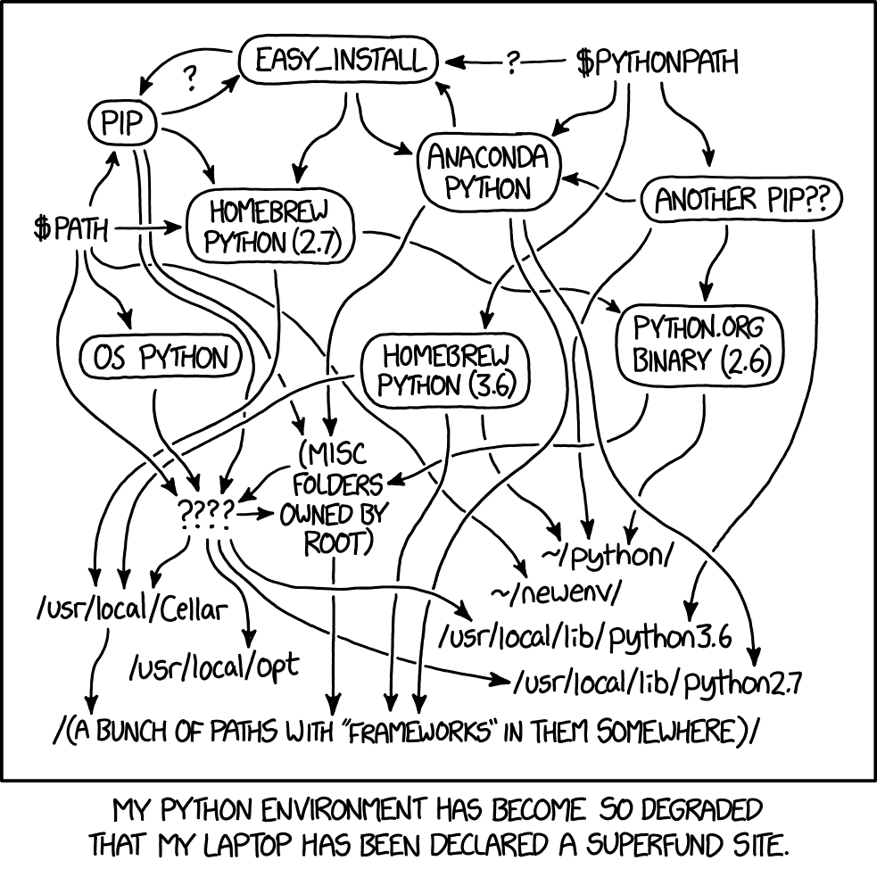
The Neutral
Environment management
Feature creep
  Negative indices
  "Python acquired lambda, reduce(), filter() and map(), courtesy of a Lisp hacker who missed them and submitted working patches” -- Guido van Rossum
Python as a teaching language, fantastic or awful?

Slide 44

The Ugly
Documentation is B A D

